Slide 1
A Mobile Sensor Network to Map CO₂ in Urban Environments
Joey Lee¹, Andreas Christen¹, Zoran Nesic², & Rick Ketler¹
Department of Geography¹
Department of Land and Food Systems²
The University of British Columbia
9th International Conference on Urban Climate
Toulouse, France
July 24, 2015

Slide 2
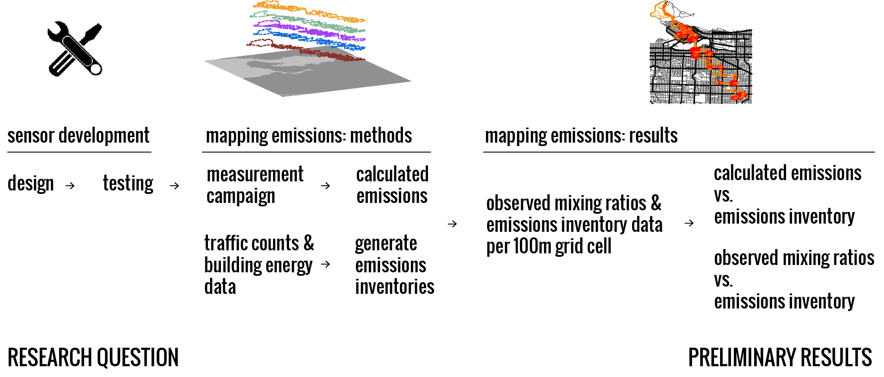
Overview
We present a pilot study to show the potential for a mobile sensor network to monitor greenhouse gas concentrations and to derive emissions in cities.

Slide 3
Research Question
Can we map greenhouse gases, specifically CO₂, at a spatial resolution of neighborhoods / blocks across the city with a network of mobile sensors?

Slide 4
Motivations: Why Mobile Sensing?

Slide 5
Motivations: Why Mobile Sensing?
Cities are a major source of GHGs into the atmosphere (Estimated 70%, Rosenzweig 2010).

Slide 6
Motivations: Why Mobile Sensing?
Cities are a major source of GHGs into the atmosphere (Estimated 70%, Rosenzweig 2010).
Currently there are a lack of tools to monitor CO₂ emissions in cities; existing tools are limited by funding, time, expertise, spatial & temporal resolution.

Slide 7
Motivations: Why Mobile Sensing?
Cities are a major source of GHGs into the atmosphere (Estimated 70%, Rosenzweig 2010).
Currently there are a lack of tools to monitor CO₂ emissions in cities; existing tools are limited by funding, time, expertise, spatial & temporal resolution.
There’s a need to validate fine scale emissions inventories.

Slide 8
Motivations: Why Mobile Sensing?
Cities are a major source of GHGs into the atmosphere (Estimated 70%, Rosenzweig 2010).
Currently there are a lack of tools to monitor CO₂ emissions in cities; existing tools are limited by funding, time, expertise, spatial & temporal resolution.
There’s a need to validate fine scale emissions inventories.
Emerging Opportunities...
Rise of flexible (open source), compact technologies.
Enhanced access to mobility services/platforms

Slide 9
But how do you go from concentrations to emissions?

Slide 10
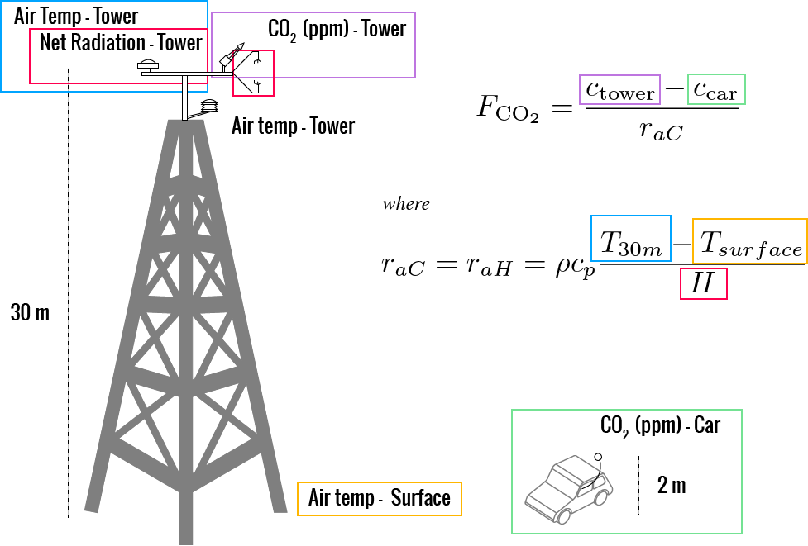
Proposed Approach: Using the aerodynamic
resistance (with a number of assumptions!)
Sensible heat flux & temperature are used to calculate the aerodynamic resistance for heat. Surface temperature is calculated with a radiometer at the surface. Assuming that that the aerodynamic resistance of CO₂ and heat are the same, the flux is computed.
Notes:
Ro = density of dry air
Cp = specific heat of air

Slide 11
The Mobile Sensor System

Slide 12
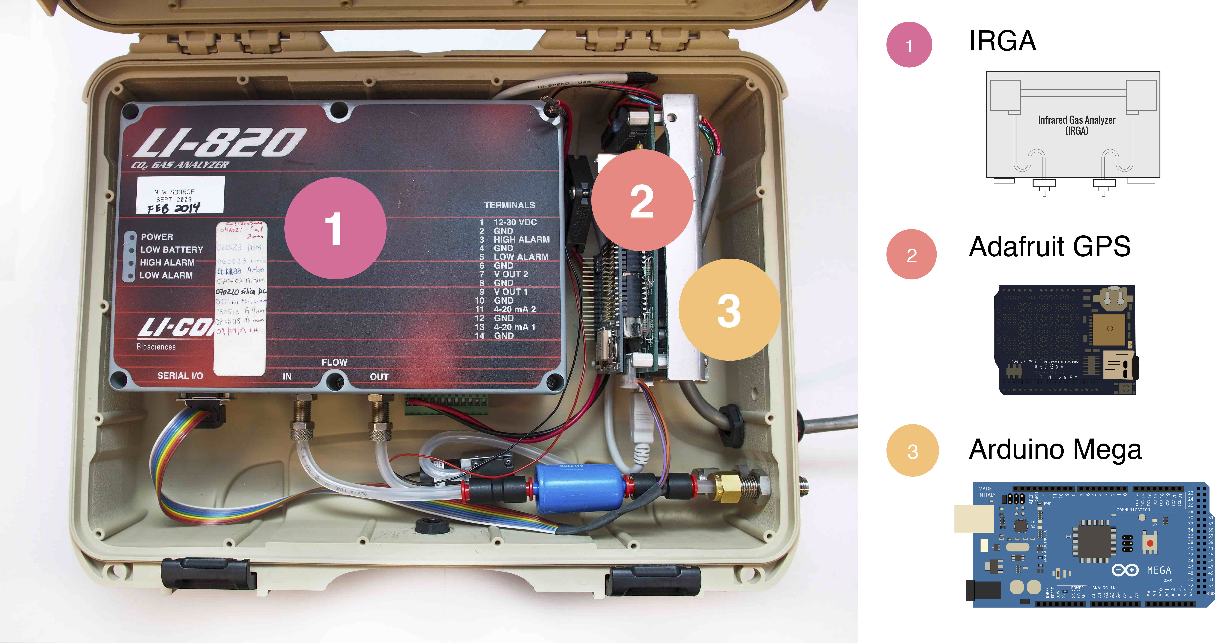
System Components
1. IRGA – Licor LI-820 (Licor Inc, Lincoln, NB, USA), 2. Adafruit GPS (Adafruit Industries, Manhattan, NY, USA), 3. Arduino Mega (Arduino CC, Ivrea, Italy) . *Not Shown: OneWire Digital Temperature Thermometer (Maxim Integrated One Wire Digital Temperature Sensor - DS18B20, San Jose, CA, USA )

Slide 13
System Specifications

Slide 14
System Specifications
Runs on 12 V Power supply

Slide 15
System Specifications
Runs on 12 V Power supply
Measures CO₂ mixing ratios (ppm), geoposition and speed, and air temperature at 1-second intervals.

Slide 16
System Specifications
Runs on 12 V Power supply
Measures CO₂ mixing ratios (ppm), geoposition and speed, and air temperature at 1-second intervals.
Size: 35.8 cm x 27.8 cm x 11.8 cm, weight: 2.6 kg.

Slide 17
System Specifications
Runs on 12 V Power supply
Measures CO₂ mixing ratios (ppm), geoposition and speed, and air temperature at 1-second intervals.
Size: 35.8 cm x 27.8 cm x 11.8 cm, weight: 2.6 kg.
Precision: +/- 1.1 ppm

Slide 18
System Specifications
Runs on 12 V Power supply
Measures CO₂ mixing ratios (ppm), geoposition and speed, and air temperature at 1-second intervals.
Size: 35.8 cm x 27.8 cm x 11.8 cm, weight: 2.6 kg.
Precision: +/- 1.1 ppm
Accuracy: +/- 3 ppm, with maximum drift of +/- 4 ppm over seven days.

Slide 19
System Specifications
Runs on 12 V Power supply
Measures CO₂ mixing ratios (ppm), geoposition and speed, and air temperature at 1-second intervals.
Size: 35.8 cm x 27.8 cm x 11.8 cm, weight: 2.6 kg.
Precision: +/- 1.1 ppm
Accuracy: +/- 3 ppm, with maximum drift of +/- 4 ppm over seven days.
Total delayed response time: 13 s with 3 m sample tube at flow rate of 700 cc/min.

Slide 20
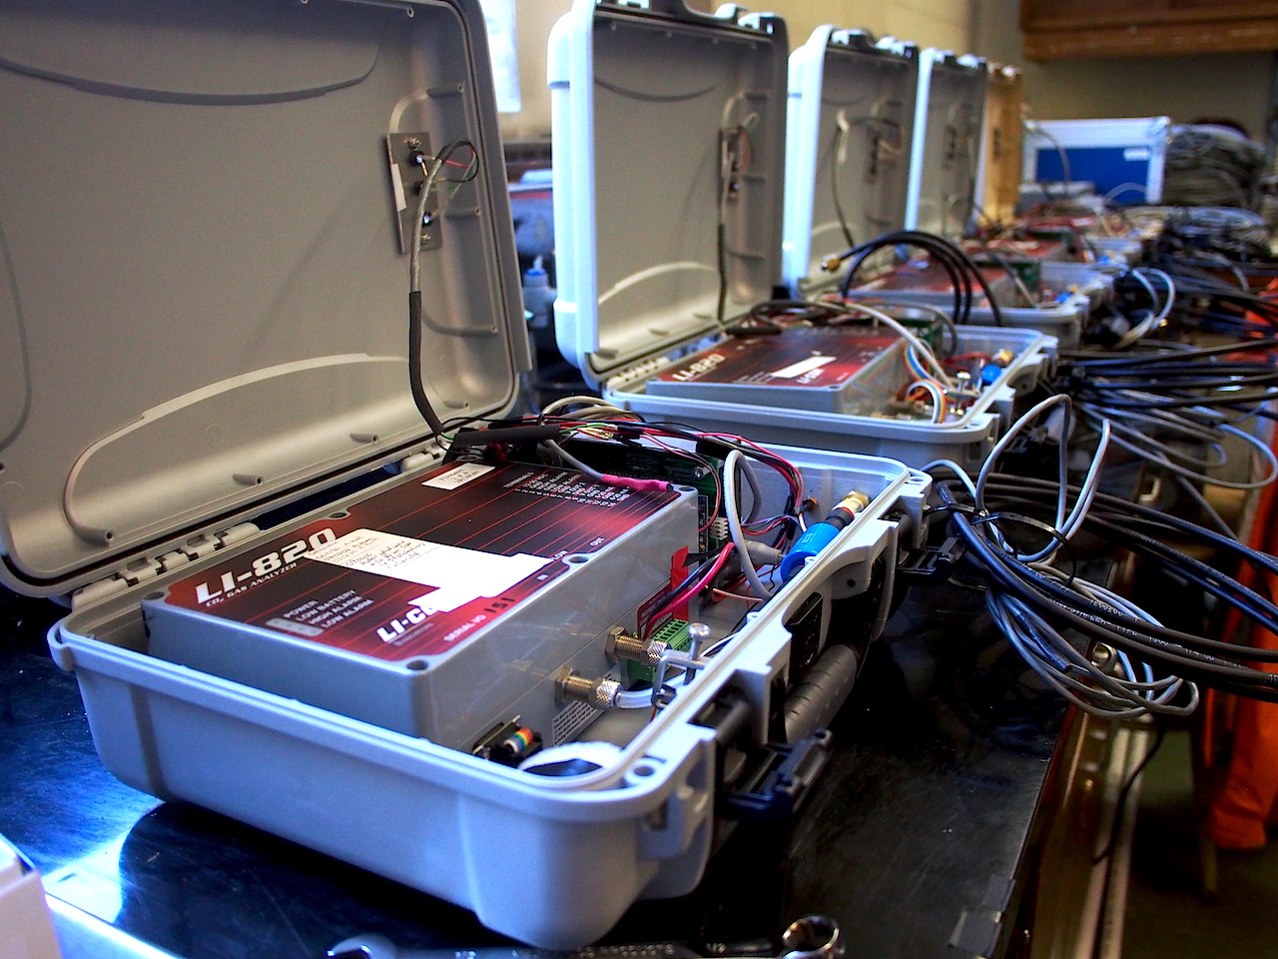
Built & Tested: 5 mobile systems
Image: In total 5 sensors were built – the image shows the full setup including the sample inlet tube and the temperature probes.

Slide 21
Mapping Emissions – Methods: Measurement Campaign
May 25th, 2015

Slide 22
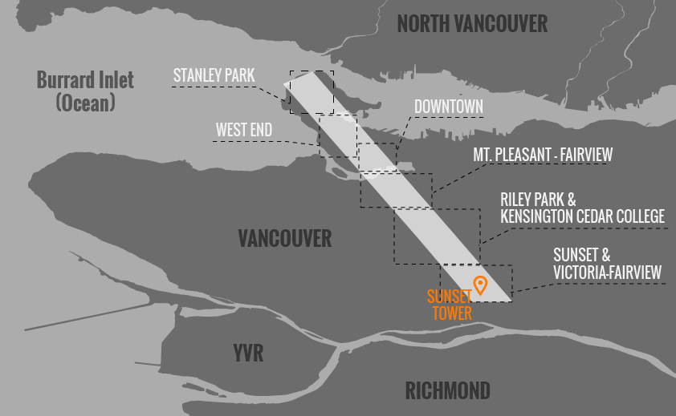
Study Area: 12.7 km² transect, Vancouver, BC
Image: 12 km² transect study area in Vancouver, BC. The transect is 1km x 12.7km covering the major land cover types in the city. Sunset Urban Climate tower is shown in orange.
Notes:
Put location of flux tower!!!

Slide 23
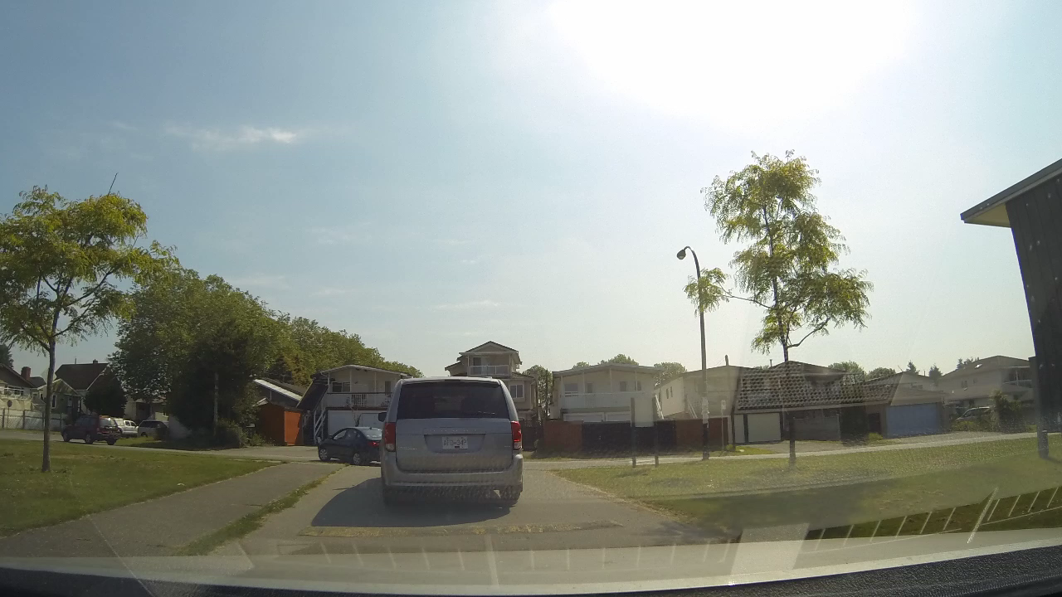
Study Area: Tour of Vancouver
Video: A tour of Vancouver during the measurement campaign as seen through a dashboard camera. Local climate zones include Forest – A, compact midrise, compact high rise, compact lowrise, and open lowrise
Notes:
(add video)

Slide 24
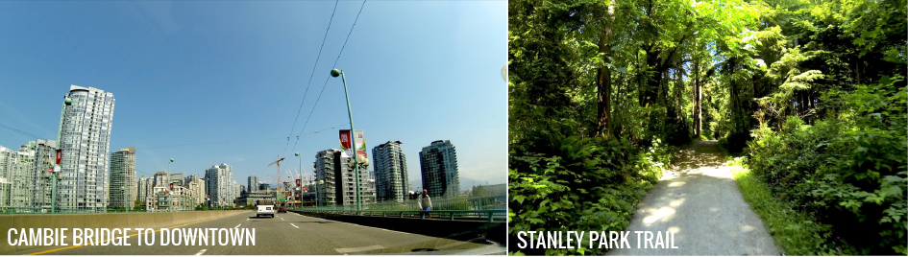
Study Area: Meteorology - May 25th, 2015
Measurement period: 10:30 – 14:00
With convective and steady weather
T_{air} = 20° - 22° C
Winds: 2.5 m/s
Cloudless
* data measured at 30m Urban Climate Tower "Vancouver Sunset" (SE section of Transect)

Slide 25
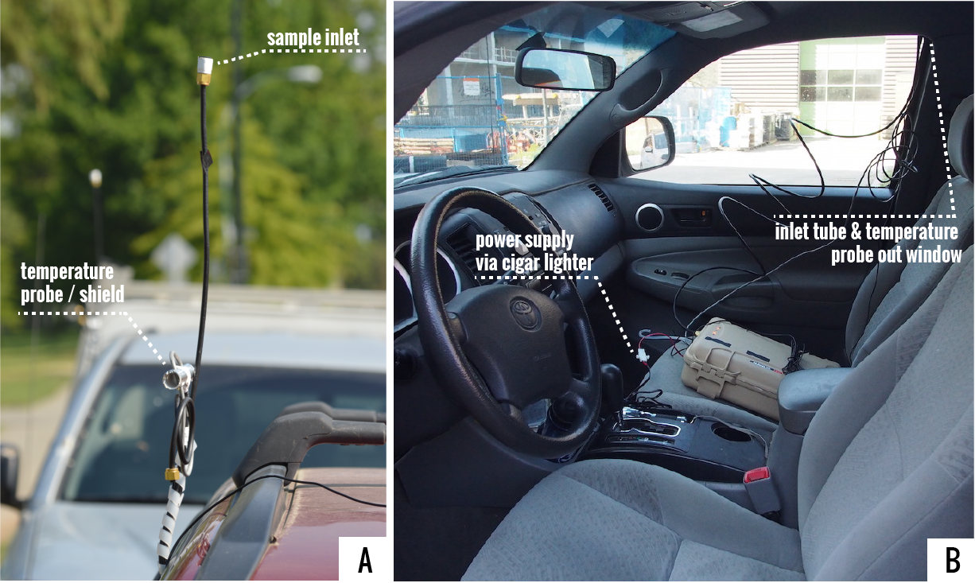
Sampling Methods: Vehicle Installation
Image A: Shows the temperature probe covered by PVC tube and reflective tape and sample inlet tube at 2m height - ±0.5°C Accuracy from -10°C to +85°C ; Image B: Shows sensor installation in vehicle.

Slide 26
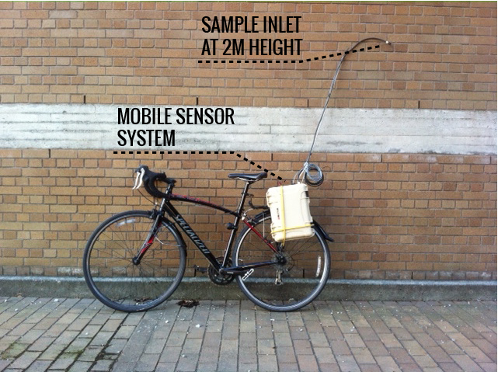
Sampling Methods: Bike Installation
Image: Shows the installation of the sensor on a bike rack – the inlet is at approximately 2m height.

Slide 27
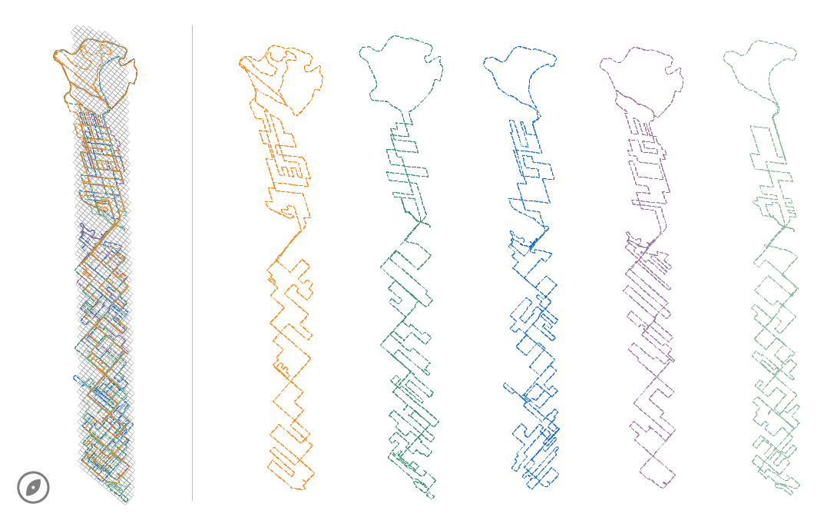
Sampling Methods: Deployment Transects
Image: The image shows 5 planned transect routes for the measurement campaign. Goal: to cover (almost) all navigable roads (and some trails) along the transect in 3.5 hours.

Slide 28
Pilot Study - Mapping CO₂ Emissions: Results

Slide 29
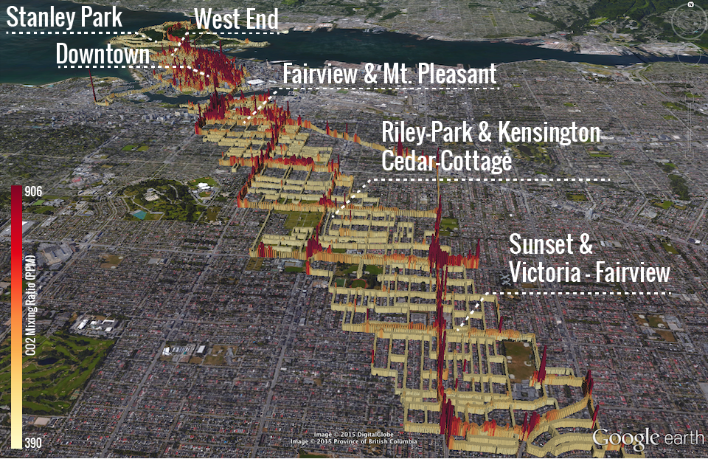
Raw Data: Visualized in Google Earth

Slide 30
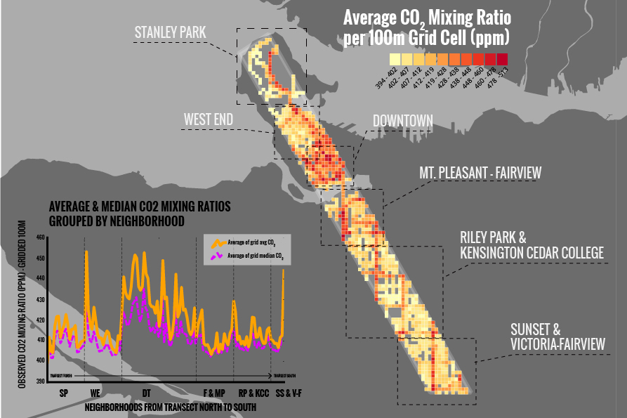
Average CO₂ Mixing Ratios per 100m Grid Cell
Notes:
Figure out which graph to put
Take out skewness!

Slide 31
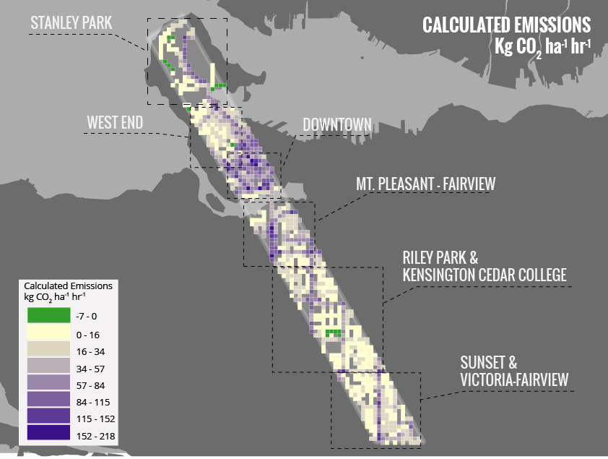
Calculated Emissions: Concentrations to Emissions
Image: Calculated emissions map generated using the aerodynamic resistance approach using CO₂ concentration measurements.

Slide 32
Mapping Emissions – Methods: Emissions Inventory

Slide 33
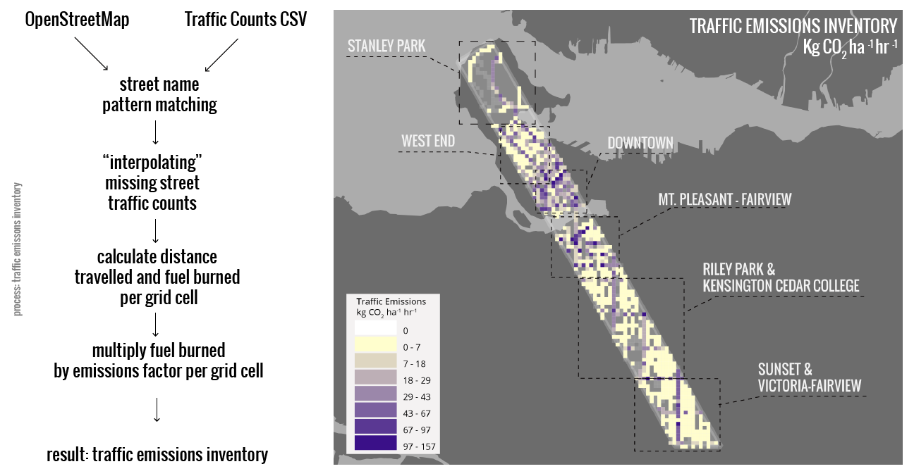
Traffic Emissions Inventory
Image: The traffic emissions inventory derived from Vancouver’s traffic count data and calculated per grid cell using fuel consumption and emissions factors.

Slide 34
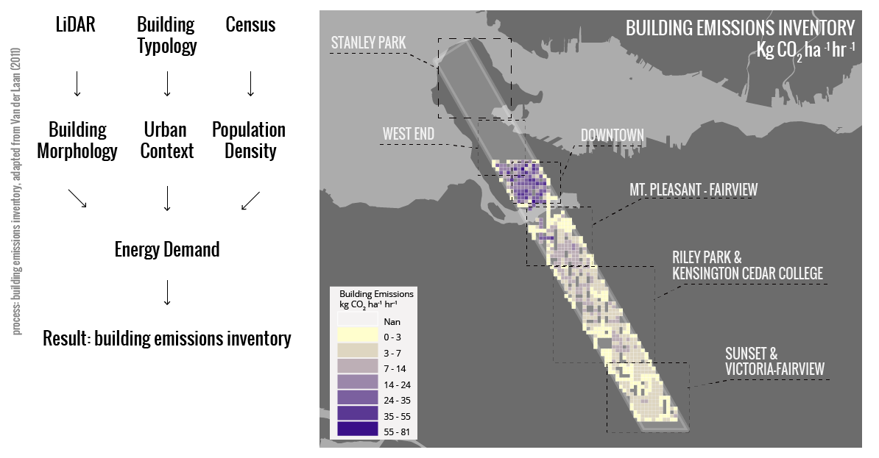
Building Emissions Inventory
Image: Building emissions inventory generated by combining factors of building morphology, urban context, and population density derived from LiDAR, building topology, and census data.

Slide 35
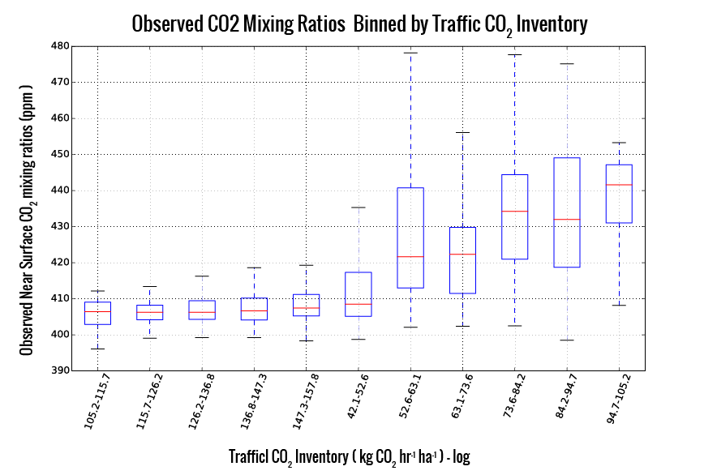
CO₂ Mixing Ratios Vs. Traffic Emissions Inventory

Slide 36
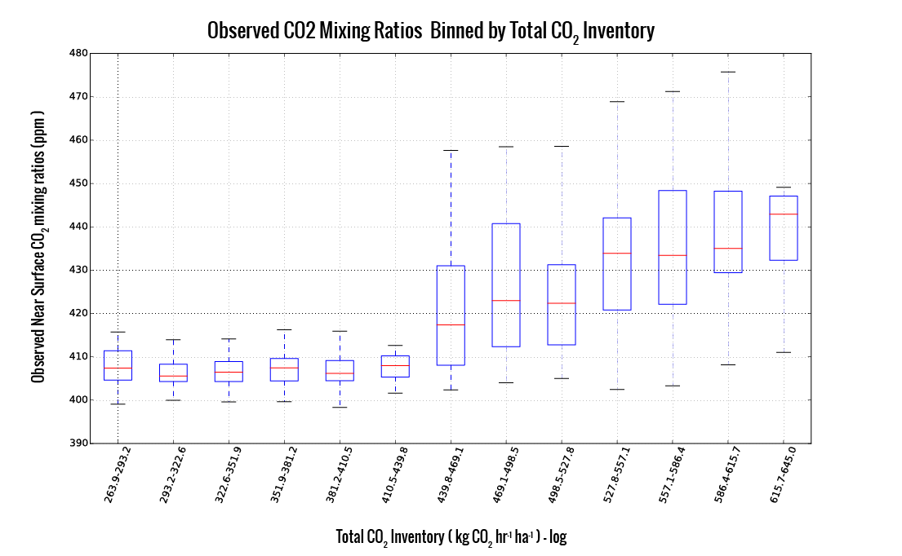
CO₂ Mixing Ratios Vs. Total Emissions Inventory

Slide 37
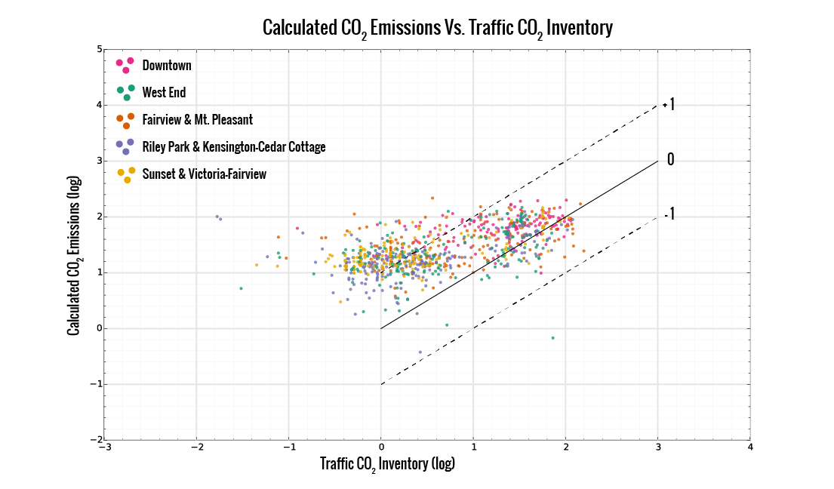
Calculated CO₂ emissions vs. Traffic Emissions Inventory

Slide 38
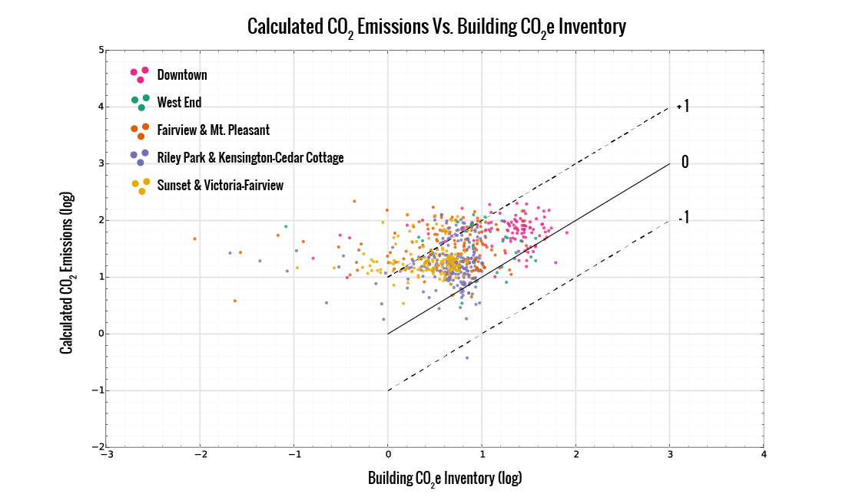
Calculated CO₂ emissions vs. Building Emissions Inventory

Slide 39
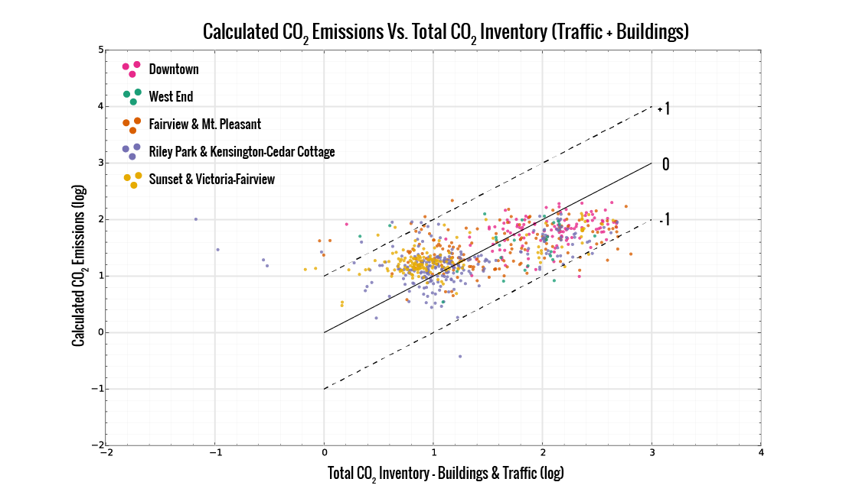
Calculated CO₂ emissions vs. Total Emissions Inventory

Slide 40
Conclusions & Future Directions

Slide 41
Conclusions & Future Directions
A mobile CO₂ sensing system was developed using opensource components.

Slide 42
Conclusions & Future Directions
A mobile CO₂ sensing system was developed using opensource components.
The system was tested in Vancouver and evaluated against traffic and building emissions inventories.

Slide 43
Conclusions & Future Directions
A mobile CO₂ sensing system was developed using open source components.
The system was tested in Vancouver and evaluated against traffic and building emissions inventories.
The study shows the potential for pervasive mobile sensing in GHG and pollutant monitoring in cities.

Slide 44
Conclusions & Future Directions
A mobile CO₂ sensing system was developed using open source components.
The system was tested in Vancouver and evaluated against traffic and building emissions inventories.
The study shows the potential for pervasive mobile sensing in GHG and pollutant monitoring in cities, but relies on specific conditions and assumptions.

Slide 45
Conclusions & Future Directions
A mobile CO₂ sensing system was developed using open source components.
The system was tested in Vancouver and evaluated against traffic and building emissions inventories.
The study shows the potential for pervasive mobile sensing in GHG and pollutant monitoring in cities, but relies on specific conditions and assumptions.
Currently exploring visualization & feedback opportunities for planning and open science.

Slide 46
Conclusions & Future Directions
A mobile CO₂ sensing system was developed using open source components.
The system was tested in Vancouver and evaluated against traffic and building emissions inventories.
The study shows the potential for pervasive mobile sensing in GHG and pollutant monitoring in cities, but relies on specific conditions and assumptions.
Currently exploring visualization & feedback opportunities for planning and open science.
Collaboration potential with local mobility providers for long term & spatially extensive/intensive monitoring

Slide 47
Acknowledgements & Funding
NSERC Discovery Grant
NSERC CREATE - Terrestrial Ecosystems Research and World Wide Education & Broadcast Program (TerreWEB).
UBC Geography Department, Ron Kellett, & Les Lavkulich
Benedikt Groß, 47Nord GmBH, & Moovel Labs
Measurement Campaign Drivers: Alex McMahon, Andreas Christen, Mark Richardson, & Thea Rodgers.
ICUC & IAUC
Data: OpenStreetMap.org, Vancouver Open Data, EPiCC Project, UBC Micrometeorology
Tools: Python, R, QGIS, GDAL/OGR, Processing
References
Van der Laan, "Scaling Urban Energy Use and Greenhouse Gas Emissions through LiDAR", MSc Thesis, 2011.
Rosenzweig, C., Solecki, W., and Hammer, S. A. (2010). Cities lead the way inclimate-change action. Nature, pages 1–3.

Slide 48
Special thanks to Andreas, Zoran, and Rick.

Slide 49
The slides & links can be found on github:
joeyklee.github.io/presentations/ICUC-JLEE-2015

Slide 50
Thanks!
Questions? Comments?
Many thanks to ICUC organizers and community.

Slide 52
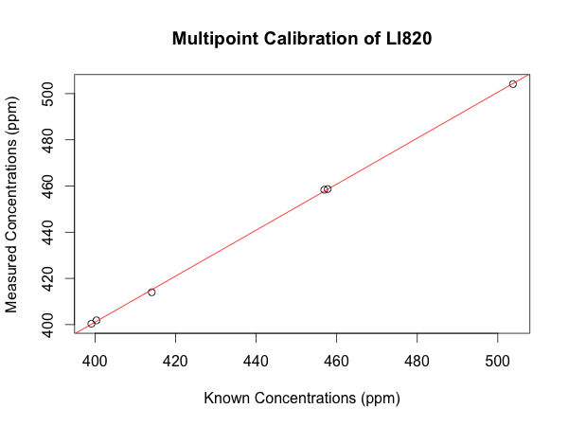
Methods: Multipoint Calibration
Image: Multipoint Calibration of Sensor System showing observed values versus known concentrations.

Slide 53
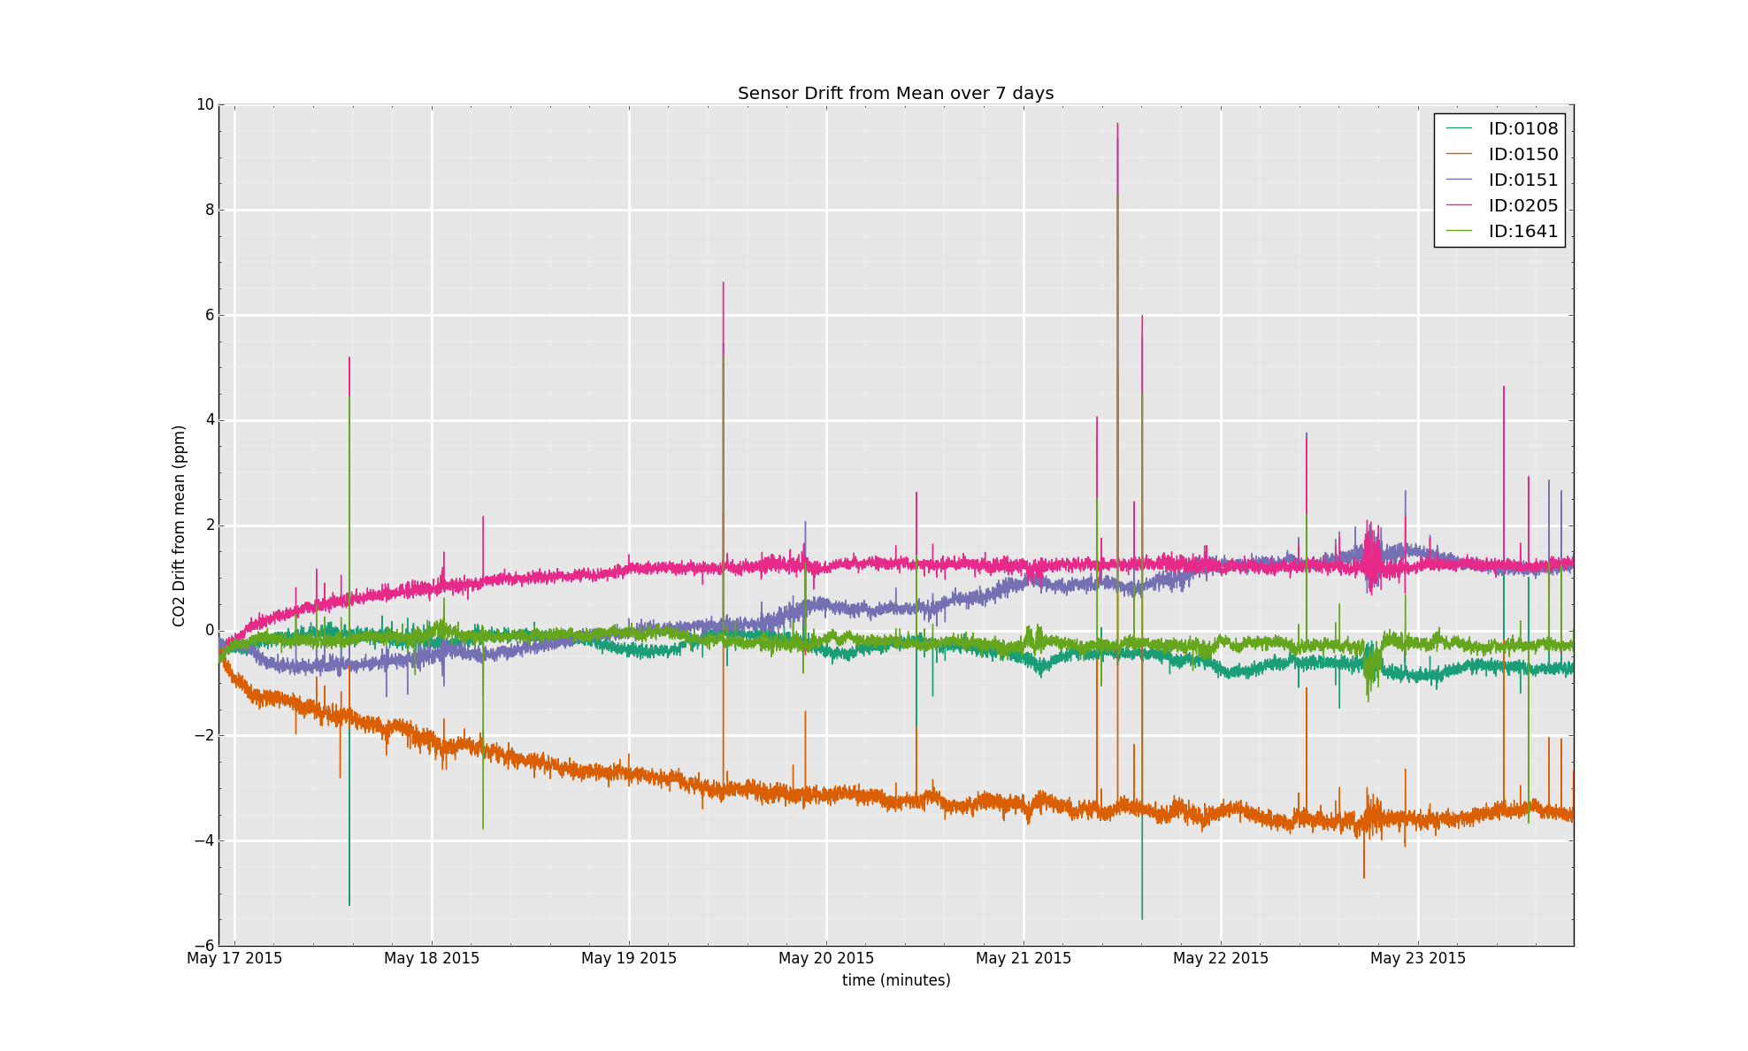
Methods: Sensor Drift
Image: Testing for sensor drift of the five mobile sensors over a seven-day measurement period. Each line corresponds to one of the five mobile CO₂ sensors.

Slide 54
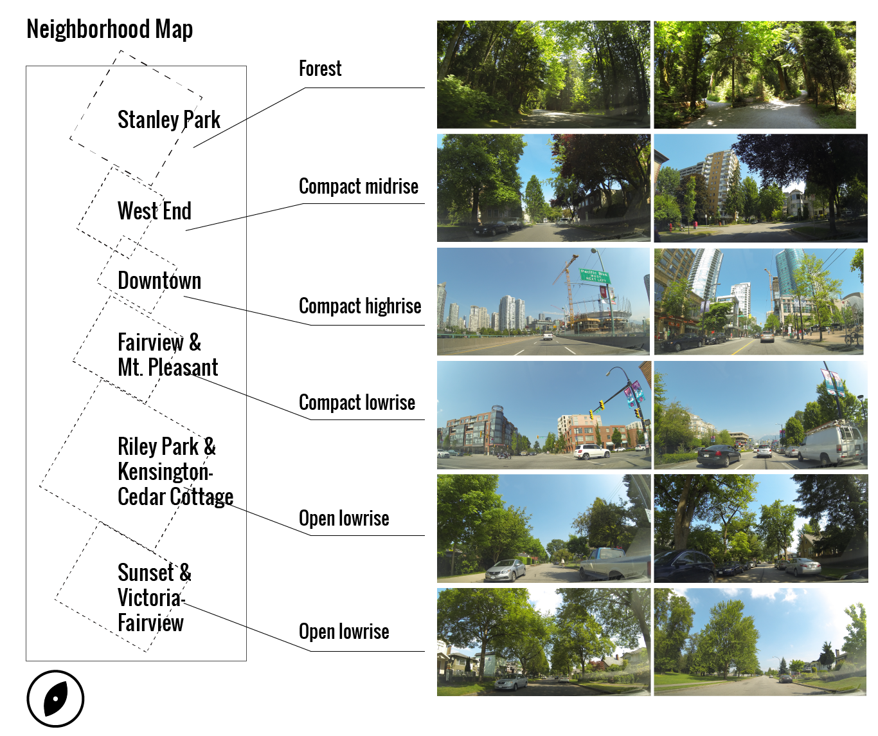
Study Area: Local Climate Zones
Image: The images above show typical urban features characteristic for each neighborhood in the study area and were taken with a dashboard camera during the measurement campaign.
Notes:
(add video)

Slide 55
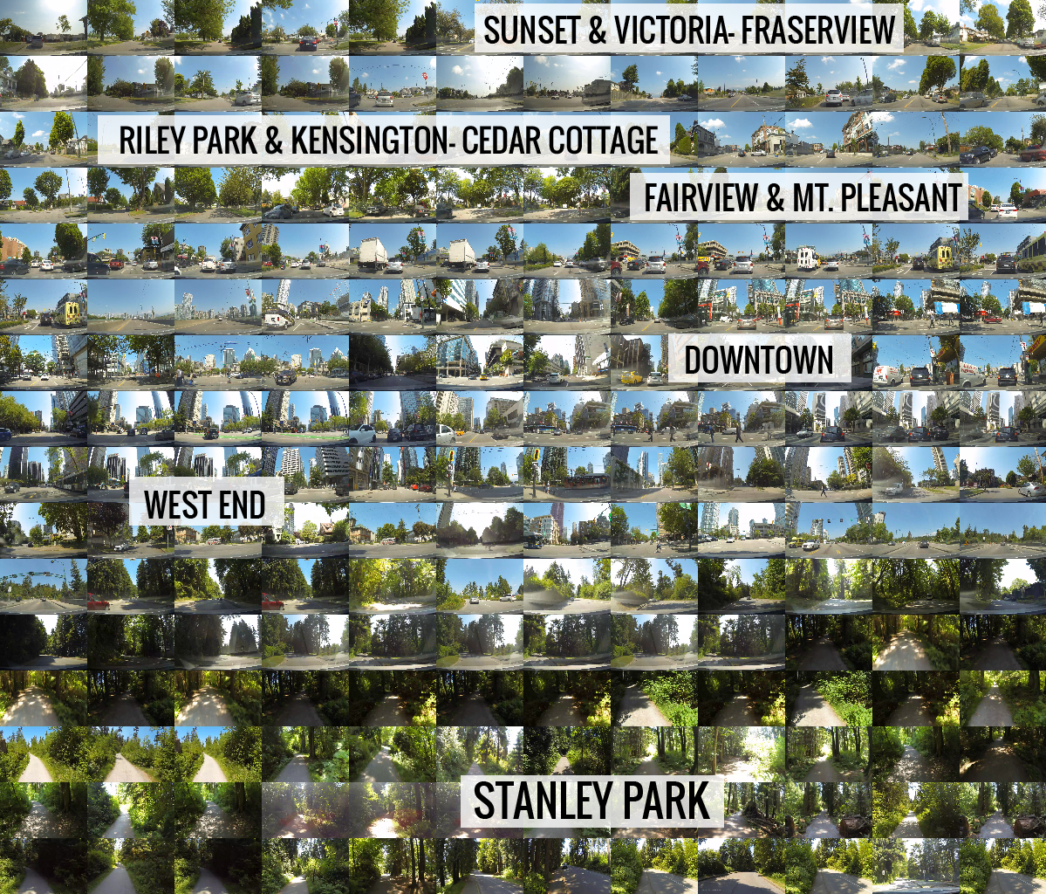

Slide 56
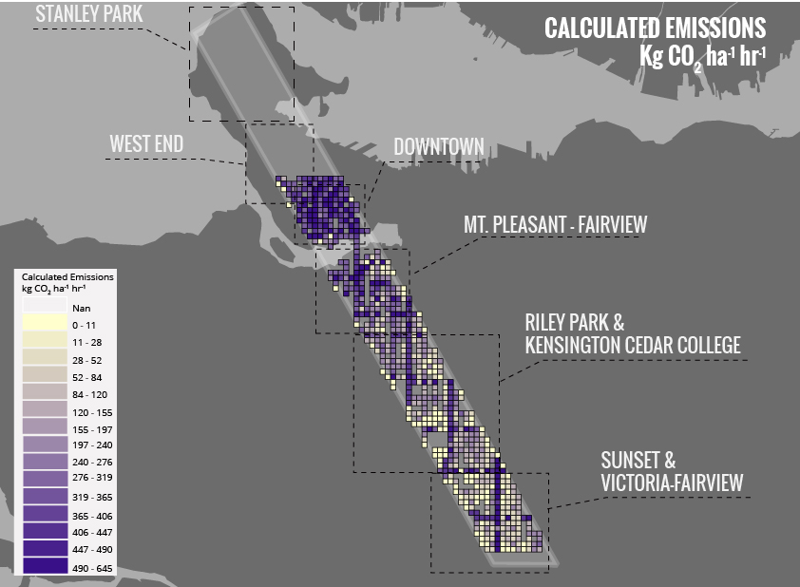
Calculated Emissions Map
Image: Calculated emissions map generated

Slide 57
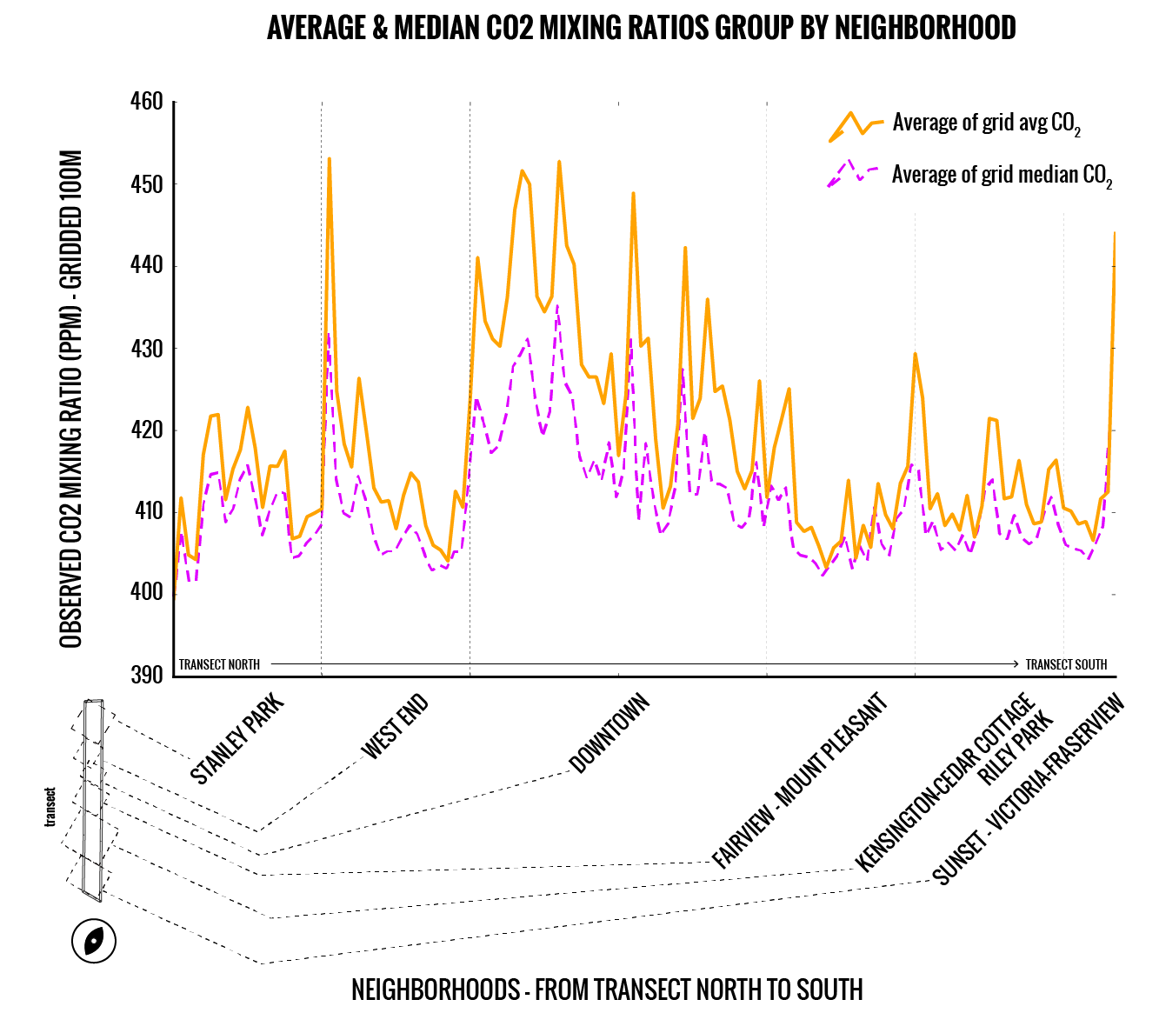
Observed Mixing Ratios: Average & Median
per 100m grid cell by neighborhood
Notes:
Figure out which graph to put

Slide 58
An Aerodynamic Resistance Approach: From Concentrations to Emissions

